Slide 1
Effects of Continuous Nitrogen Fertilizer Application on the Diversity and Composition of Rhizosphere Soil Bacteria Ren et al. 2020
Gurpreet Kaur
Amplicon Sequencing Project-BIOMI 6300

Slide 2
Field experiment and sample collection
Three replications (Randomized Complete Block design)
Study period from 2009 to 2019
Wheat rhizospheric soil samples collected during the harvest years as:
1st (2010)
5th (2014)
10th (2019)
S.N. | Treatment | Nitrogen applied (kg N hm⁻²)
1 | N₀ | 0
2 | N₁₂₀ | 120
3 | N₁₈₀ | 180
4 | N₂₄₀ | 240
5 | N₃₆₀ | 360
2
Notes:
Fluvoaquic soil is derived from alluvial soil.

Slide 3
DNA extraction and PCR amplification
Amplifying V3-V4 hypervariable regions of bacterial 16S rRNA gene
Two primers:
338F (5′-ACTCCTACGGGAGGCAGCAG-3′) and
806R (5′-GGACTACHVGGGTWTCTAAT-3′)
Illumina MiSeq (paired-end sequenced, 2*300)
3

Slide 4
Research questions
How does diversity and richness of bacterial communities differ with various nitrogen fertilizer levels?
What is the long-term effect of fertilization on the diversity and microbial community composition?
4

Slide 5
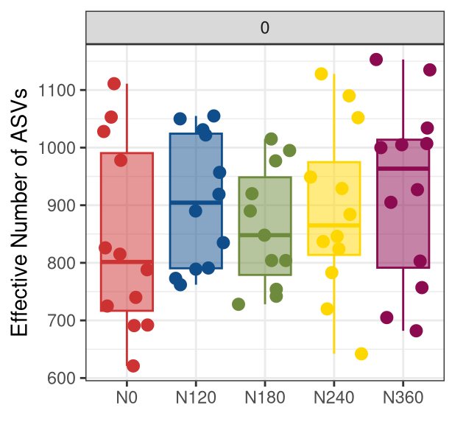

N120 in contrast to the paper has higher average relative richness!
Richness
5

Slide 6
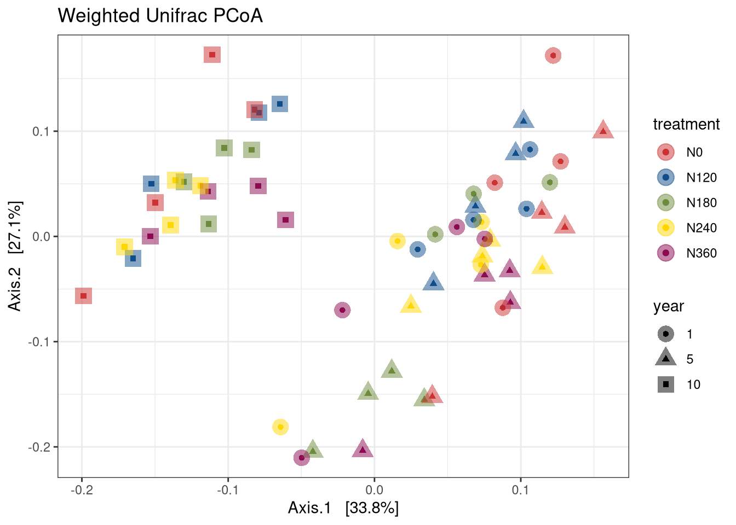
Year of sampling is the major driver for microbial community composition
Explains ~61% variability
PERMANOVA (Year)
R2: 33%
F-statistic: 22
P-value: <0.001
6

Slide 7
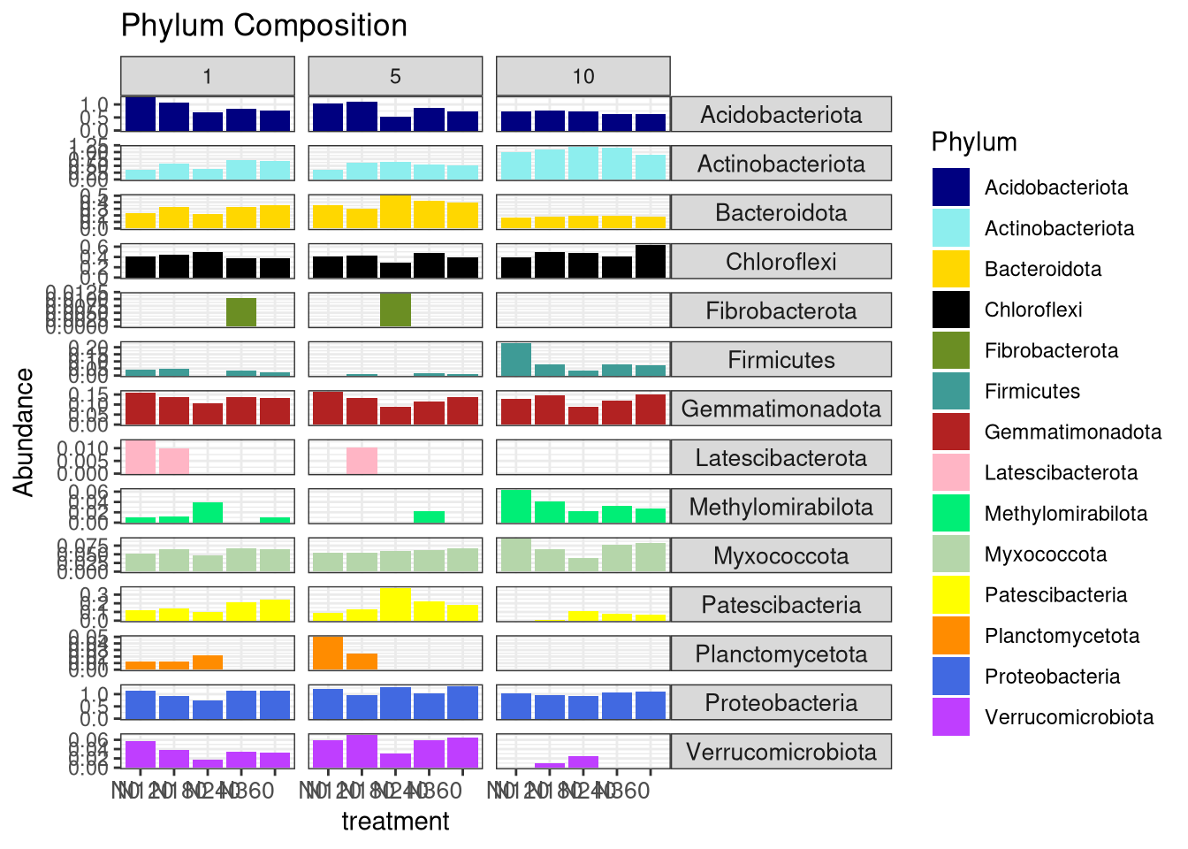
Average relative richness of dominant bacterial species among the treatments gradually decreased over the years.
N0 N120 N180 N240 N360
N0 N120 N180 N240 N360
N0 N120 N180 N240 N360
Treatment
7

Slide 8
Conclusions
Diversity and richness of bacterial communities was highest for N120 and lowest for N180 (incontrast to the paper).
Diversity and microbial community composition gradually decreased with long term N-fertilizer application.
8

Slide 9
Thank you!
9

